Slide 1
ASEHolder Charts

Slide 2
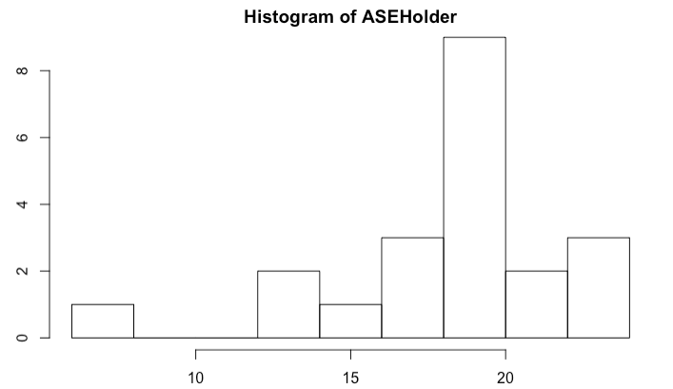
ASEHolder – Multivariate (no trend and no lag)

Slide 3
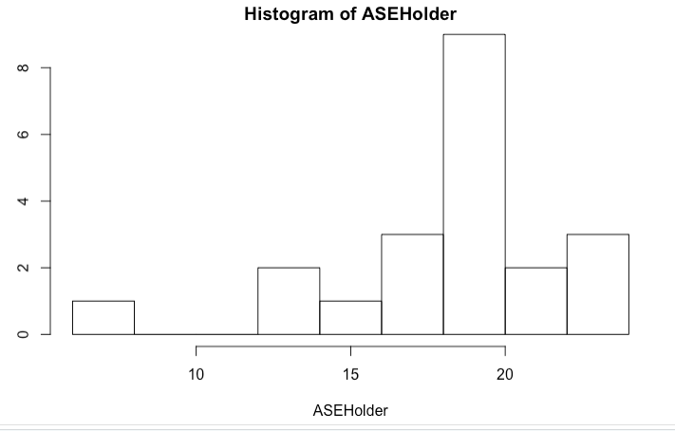
Multivariate – Trend added, no lag

Slide 4
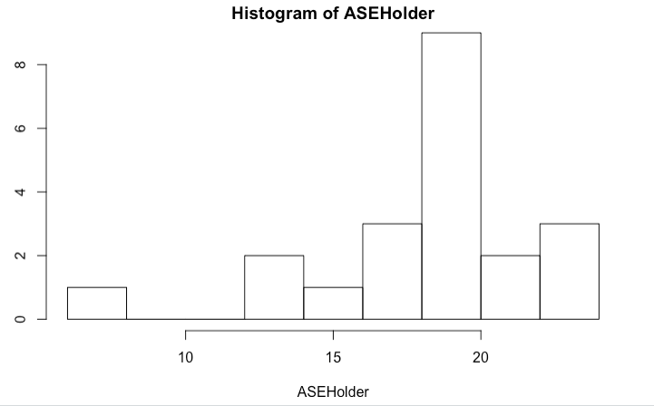
Multivariate – Trend and Lag added

